Slide 1
DevOps Enterprise Summit
How the Infrastructure Product Model accelerated delivery and transparency to drive outcomes and increase engagement

Slide 2
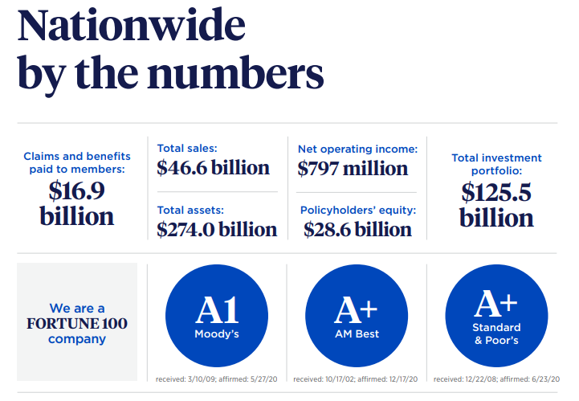
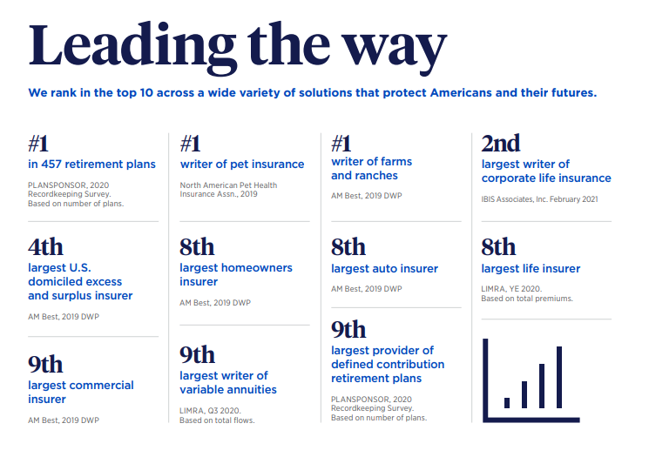
Who is Nationwide

Slide 3

Who am I
Tod Bickley: Associate Vice President in Technology Engineering
Technology Product Manager for Identity and Access Management (IAM)
Over 25 Years of experience in Technology with a focus and passion for Identity and Access Management – and now Product Model delivery practices

Slide 4

Identity and Access Managements Journey to an Infrastructure Product Model
Nationwide’s development teams focused on developing Agile and DevOps practices starting in 2006
Centralized development in a Development Center in 2008 expending to full scale Agile DevOps lines (225+) across the enterprise by 2016
Infused LEAN, Scrum, Kanban – All the “things”
But what about Infrastructure?

Slide 5

Identity and Access Managements Journey to an Infrastructure Product Model
Infrastructure teams still operated in a Plan, Build and Run Model – LOTS of Handoffs
No consistent demand process
No consistent prioritization process or “owners” of prioritization
No true customer feedback
No way to track “how much” work gets completed, or can be completed in a timeframe

Slide 6

Identity and Access Managements Journey to an Infrastructure Product Model
How did the IAM Team address these issues to increase delivery, provide new capabilities, reduce risk, improve relationships with business partners and increase the engagement of the engineers on the team?
Where do you start?
It starts with People…

Slide 7

Identity and Access Managements Journey to an Infrastructure Product Model
Re-defining the Engineering Jobs to support Product driven Delivery through Agile Practices. Three key jobs were defined to support this model:
Technology Delivery Professional: Manages the FLOW of work in an Agile team but also has the technical ability to “pull cards” and do hands on engineering
Technology Product Manager: Accountable for the end-to-end management of a Technology product
Technology Product Owner: Accountable for setting priority with the Technology Product Manager and working closely with engineering and business teams.

Slide 8
Identity and Access Managements Journey to an Infrastructure Product Model
Redesign the organization into a product specific “build it run it” model with end-to-end accountability for IAM Products. Each Product team is led by a Technology Product Manager and Supported by a Technology Delivery Professional. An executive level Technology Product Manager is accountable for all three Product Teams.
Infrastructure & Operations:
Product Management
Identity Lifecycle Management
Directory and Certificate Services
Single Sign On & Multi Factor Authentication
Technology Delivery Professional: Manages the FLOW of work in an Agile team but also has the technical ability to “pull cards” and do hands on engineering
Technology Product Manager: Accountable for the end-to-end management of a Technology product

Slide 9
Identity and Access Managements Journey to an Infrastructure Product Model
Identify an organization* that can perform the role of Product Owner. In the case if IAM at Nationwide the Information Risk Management Team (IRM) had similar organization that focused on IAM policies and capability adoption. The IRM Product Team also has an executive level Product Owner that faces off to the Executive level Product Manager.
Information Risk Management:
Product Ownership
IAM Authentication Services
Internal and External IAM Services
IRM IAM Lifecycle Management
Technology Product Owner: Accountable for setting priority with the Technology Product Manager and working closely with engineering and business teams
* Form an Infrastructure Product perspective, it may be difficult to identify a single Product Ownership Organization. Product Ownership could also be executed through a federated model

Slide 10
Identity and Access Managements Journey to an Infrastructure Product Model
IAM Steering Committee
Enterprise IAM Governance
At Nationwide, a three-year multi million-dollar program was created to reduce risk and add/upgrade IAM capabilities. To support this program, Steering and Governance were also introduced to set direction and ensure alignment across the organization.
IAM Product Management: “One Team”
IRM: Product Ownership
I&O: Product Management
Federated IAM Orgs (App and Business)
The combined I&O IAM Team and the IRM IAM Product Team form an overall IAM Product Team
The overall IAM Product Team is accountable for all delivery and operations of the IAM products
The combined team is “One Team” they win together and fail together
IAM Architecture
IAM AuthN Services
Int/Ext IAM Services
IRM IAM LifeCycle Mgt
Identity Lifecycle Management
Directory and Certification Services
SSO & MFA

Slide 11
Identity and Access Managements Journey to an Infrastructure Product Model
Defining where expense occurs in the different “types” of work is critical to understanding how your Unit Cost is managed
External Demand - IAM Program Capability Build & Adoption
Discretionary activities in support of the Tier 2 IAM Program. Priorities set by IAM Steering Committee.
External Demand
IAM Program
External Demand
All Other
External Demand – All Other
Discretionary activities in support of non IAM program Demand.
Operational
Support
Product
Evolution
Operational Support
Non Discretionary activities to support the availability and health of the product. Includes support from IRM.
Product Evolution
Semi Discretionary activities to support product development.
11

Slide 12









Identity and Access Managements Journey to an Infrastructure Product Model
Once your roles are defined and your teams are organized into product teams (for both product management and product ownership) it’s time to develop your OKR’s inject your Agile, LEAN and DevOps capabilities!
Delivery in a Product Centric Model
Product Principles - FLOW
Establish a common vocabulary and inject use of enterprise tools (JIRA) to manage and make visible all work execution – “Learn by Doing”. Categorize workflow by Product Category
Customer Centricity
Adopt a Customer Centric Mindset. Implement micro surveys, group feedback sessions and interviews with consumers, Create metrics and scoring
Priority Alignment
Consistent Product Backlog grooming for 30/60/90 commitments. Working closely with Product Owners to ensure ALL demand (Build and Run) is reviewed and prioritized
Product Strategy
Integrated IAM Roadmap Alignment for IAM Governance and Steering.
Develop, track and report standardized FLOW metrics for release, demand, cycle time and workforce planning
LEAN Management Systems
Implement Leader Standard Work, Standups and Huddles. TDP’s actively facilitate these sessions with Engineers, Product Managers and Product Owners
Managing Through Metrics

Slide 13

Identity and Access Managements Journey to an Infrastructure Product Model
The Identity and Access Management team is 14 months into its Product Journey. What have we experienced?
Clear priority into all the active and backlog work. Big Room Planning drives commitments to 30/60/90 day deliverables.
Engineers have clear line of sight to what they work on everyday. “If it’s not in JIRA, it doesn’t exist”. Higher Engagement.
Transparency into our financials. Defined Unit Cost and “Cost Per ID”.
Velocity. We now know how much we can complete in a release cycle.

Slide 14


Identity and Access Managements Journey to an Infrastructure Product Model
What are the key factors for success in implementing a product model?
Executive Sponsorship
A team that can “Lean In” to change
Having a dynamic Technology Delivery Professional
Alignment and buy in from your Product Owner(s)

Slide 15

Identity and Access Managements Journey to an Infrastructure Product Model
Here’s the help I’m looking for
Experience with Product Ownership where a single Product Owner is not clear
Implementing a TDP like role broadly across an organization. The mix of technical skills and Agile skills.

